Slide 1
File Forensics

Slide 2
File Forensics
Commonly used tools/commands:
binwalk/foremost
xxd
file
strings
exiftool
pngcheck
readelf
objdump
Hex editor

Slide 3
File Signatures
Specific sequence of bits that identifies the type of file for recognition by a program
e.g. a ZIP file has a header of hex 50 4B 03 04, which allows multiple programs to recognize it and handle it appropriately as a ZIP file
A file’s extension may not always reflect the true type of file it is, in which case the file signature may lend clues to what it actually is
Source: https://www.garykessler.net/library/file_sigs.html

Slide 4
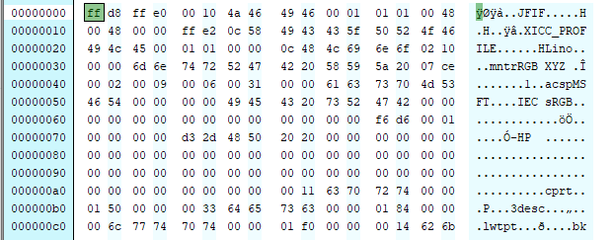
File Signatures
If there is a discrepancy between a file’s extension and file signature or if the file is corrupted, we can examine and repair the file using a hex editor
Figure 1: A JPEG file loaded into a hex editor. Note the file signature "JFIF" (4A 46 49 46) identifying it as a JPEG

Slide 5
PDF Files
Much more complex than most file types
Includes a header with the magic number %PDF-1.7, list of objects, reference table, and trailer
Trailer contains:
A dictionary
An offset to the start of the cross-reference table (the table starting with the xref keyword)
And the %%EOF end-of-file marker.
The dictionary contains:
A reference to the root object of the tree structure, also known as the catalog
The count of indirect objects in the cross-reference table
And other optional information.

Slide 6
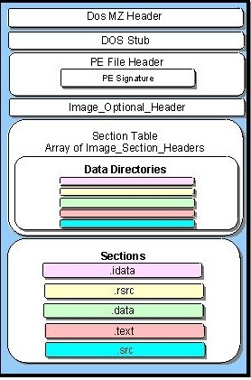
Portable Executable (PE) Files
File format used for x86 and x64 Windows files including executables, object code, DLLs, and core dumps
Consists of two main sections that are subdivided: Header and Section
Magic number: MZ (0x54AD)
Can be analyzed with static analysis tools like IDA Pro or CFF Explorer
Source: https://resources.infosecinstitute.com/2-malware-researchers-handbook-demystifying-pe-file/#gref

Slide 7
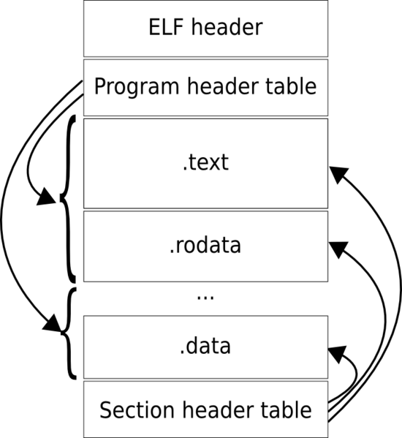
Executable and Linkable Format (ELF) Files
Standard binary file format for Unix and Linux systems on x86 processors
Consists of a header followed by
program data
The standard sections are displayed
in the image on the right
Program header shows segments
used at run-time, while the section
header shows set of sections used
for linking and relocation
readelf is a useful Unix utility for
examining ELF files

Slide 8
File Carving
Can refer to “carving” file from a physical disk without assistance from a file manager or to “carving” data from a file to reconstruct it or to extract embedded files
In this module, we are discussing the latter

Slide 9
Types of Carving
Block-Based Carving Any carving method (algorithm) that analyzes the input on block-by-block basis to determine if a block is part of a possible output file. This method assumes that each block can only be part of a single file (or embedded file)
Statistical Carving Any carving method (algorithm) that analyzes the input on characteristic or statistic for example, entropy) to determine if the input is part of a possible output file
Header/Footer Carving A method for carving files out of raw data using a distinct header (start of file marker) and footer (end of file marker)
Header/Maximum (file) size Carving A method for carving files out of raw data using a distinct header (start of file marker) and a maximum (file) size. This approach works because many file formats (e.g. JPEG, MP3) do not care if additional junk is appended to the end of a valid file
File Carving Taxonomy – Simson Garfinkel and Jachim Metz

Slide 10
Types of Carving
Header/Embedded Length Carving A method for carving files out of raw data using a distinct header and a file length (size) which is embedded in the file format File structure based Carving A method for carving files out of raw data using a certain level of knowledge of the internal structure of file types. Garfinkel called this approach "Semantic Carving" in his DFRWS2006 carving challenge submission, while Metz and Mora called the approach "Deep Carving." Semantic Carving A method for carving files based on a linguistic analysis of the file's content. For example, a semantic carver might conclude that six blocks of french in the middle of a long HTML file written in English is a fragment left from a previous allocated file, and not from the English-language HTML file
Carving with Validation A method for carving files out of raw data where the carved files are validated using a file type specific validator
File Carving Taxonomy – Simson Garfinkel and Jachim Metz

Slide 11
Types of Carving
Fragment Recovery Carving A carving method in which two or more fragments are reassembled to form the original file or object. Garfinkel previously called this approach "Split Carving.“
Repackaging Carving A carving method that modifies the extracted data by adding new headers, footers, or other information so that it can be viewed with standard utilities. For example, Garfinkel's ZIP Carver looks for individual components of a ZIP file and repackages them with a new Central Directory so that they can be opened with a standard unzip utility.
File Carving Taxonomy – Simson Garfinkel and Jachim Metz

Slide 12
File Carving as applied to IDS
Certain intrusion detection systems support automated file extraction and carving from captured network traffic
Suricata and Bro are two such examples
Carving can be applied based on filtering n filenames, magic signature, file extensions, transaction signature, etc.
Extracted files can then be analyzed for maliciousness

Slide 13
File Carving Challenges
File Carving Challenge - DFRWS 2006
File Carving Challenge - DFRWS 2007
FAT Undelete Test #1 - Digital Forensics Tool Testing Image (dftt #6)
NTFS Undelete (and leap year) Test #1 - Digital Forensics Tool Testing Image (dftt #7)
Basic Data Carving Test - fat32, Nick Mikus - Digital Forensics Tool Testing Image (dftt #11)
Basic Data Carving Test - ext2, Nick Mikus - Digital Forensics Tool Testing Image (dftt #12)

